Slide 1
Lecture 12 Minimum Spanning Trees
Jianchen Shan
Department of Computer Science
Hofstra University

Slide 2
Lecture Goals
In this lecture we study the minimum spanning tree problem.
We begin by considering a generic greedy algorithm for the problem.
Next, we consider and implement two classic algorithm for the problem—Kruskal's algorithm and Prim's algorithm.
We conclude with some applications and open problems.

Slide 3
Minimum Spanning Tree (MST)
Given. Undirected graph G with positive edge weights (connected).
Def. A spanning tree of G is a subgraph T that is both a tree (connected and acyclic) and spanning (includes all of the vertices).
Goal. Find a min weight spanning tree.
4
24
4
24
23
9
23
9
6
18
6
18
5
11
5
11
16
8
16
8
10
14
7
10
14
7
21
Brute force.
Try all spanning trees?
21
graph G
not connected
4
24
4
24
23
9
23
9
6
18
6
18
5
11
5
11
16
8
16
8
10
14
7
10
14
7
21
21
not acyclic
spnning tree T: cost = 50 = 4 + 6 + 8 + 5 + 11 + 9 + 7

Slide 4
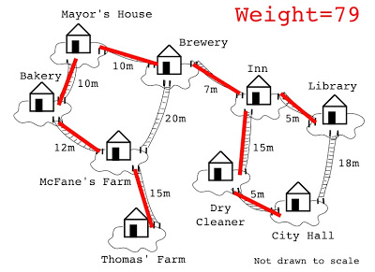
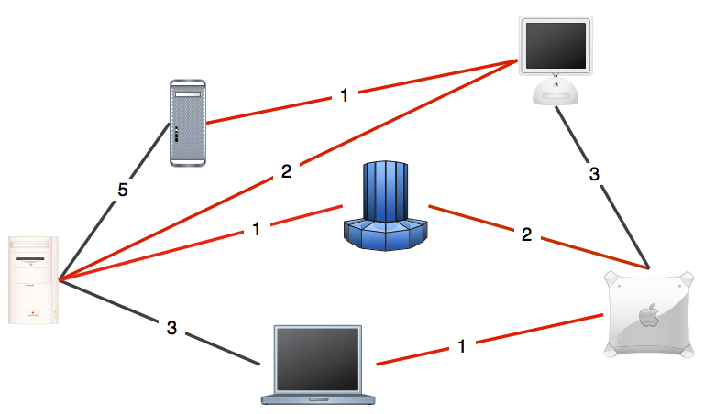
MST Applications
One example would be a telecommunications company trying to lay cable in a new neighborhood. If it is constrained to bury the cable only along certain paths (e.g. roads), then there would be a graph containing the points (e.g. houses) connected by those paths.
Some of the paths might be more expensive, because they are longer, or require the cable to be buried deeper; these paths would be represented by edges with larger weights.
A MST would be one with the lowest total cost, representing the least expensive path for laying the cable.
Network design.
Cluster analysis.
Indirect applications.

Slide 5
Simplifying Assumptions and Cut Property
Assumptions. Edge weights are distinct; Graph is connected.
Consequence. MST exists and is unique.
Def. A cut in a graph is a partition of its vertices into two (nonempty) sets.
Def. A crossing edge connects a vertex in one set with a vertex in the other.
Property. Given any cut, the crossing edge of min weight is in the MST.
Pf. Suppose min-weight crossing edge e is not in the MST.
Adding e to the MST creates a cycle.
Some other edge f in cycle must be a crossing edge.
Removing f and adding e is also a spanning tree.
Since weight of e is less than the weight of f,
that spanning tree is lower weight.
Contradiction
crossing edge separating red and white vertices
4
24
23
9
6
18
f
5
16
8
11
e
no two edge weights are equal
10
14
7
21
the MST does not contain e
minimum-weight crossing edge must be in the MST
adding e to MST creates a cycle

Slide 6
Greedy MST Algorithm
Start with all edges colored gray.
Find cut with no black crossing edges; color its min-weight edge black.
Repeat until V - 1 edges are colored black.
1
6
1
6
1
7
3
3
7
3
3
11
2
11
5
5
7
8
2
15
5
7
8
2
5
5
7
2
9
12
1
0
4
14
0
4
9
0
4
13
16
4
16
4
17
6
6
6
1
1
1
3
3
7
3
11
2
3
11
2
5
7
2
15
5
7
8
2
15
5
7
2
15
0
14
9
12
1
0
0
4
17
16
6
4
6
4
6
1
6
1
1
7
3
3
3
3
11
5
7
2
5
7
2
5
7
2
9
12
0
9
12
0
0
4
13
4
13
4
17
6
17
6
6

Slide 7
Greedy MST Algorithm: Correctness Proof
Proposition. The greedy algorithm computes the MST.
Proof.
Any edge colored black is in the MST (via cut property).
Fewer than V - 1 black edges → cut with no black crossing edges.
(consider cut whose vertices are one connected component)
1
9
3
9
2
4
7
2
1
9
a cut with no black crossing edges
fewer than V-1 edges colored black
3
9
2
What if edge weights are not all distinct?
4
7
2
Greedy MST algorithm still correct if equal weights are present
What if graph is not connected?
1
3
5
2
6
Compute minimum spanning forest = MST of each component.
4
7

Slide 8
Weighted Edge API
public class Edge implements Comparable<Edge>
Edge(int v, int w, double weight) //create a weighted edge v-w
int either() // either endpoint
int other(int v) // the endpoint that's not v
int compareTo(Edge that) // compare this edge to that edge
double weight() // the weight
String toString() // string representation
weight
v
w
Idiom for processing an edge e: int v = e.either(), w = e.other(v);

Slide 9
Weighted Edge: Java Implementation
public class Edge implements Comparable<Edge>
{
private final int v, w;
private final double weight;
public Edge(int v, int w, double weight)
{
this.v = v; this.w = w;
this.weight = weight;
}
constructor
public int either()
{ return v; }
public int other(int vertex)
{
if (vertex == v) return w;
else return v;
}
either endpoint
other endpoint
public int compareTo(Edge that)
{
if (this.weight < that.weight) return -1;
else if (this.weight > that.weight) return +1;
else return 0;
compare edges by weight
}
}

Slide 10
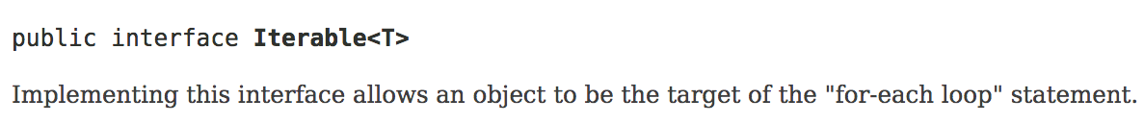
Edge-Weighted Graph API
public class EdgeWeightedGraph
EdgeWeightedGraph(int V) // create an empty graph with V vertices
void addEdge(Edge e) // add weighted edge e to this graph
Iterable <Edge> adj(int v) // edges incident to v
Iterable <Edge> edges() // all edges in this graph
int V() // number of vertices
int E() // number of edges
String toString() // string representation
Class that implements Iterable interface, can be used in the for-each loop to retrieve elements one by one.
Most collections either implement Iterable interface or have a view that returns one (such as Map's keySet() or values())
Iterable<String> myIterable
for (String str : myIterable) { ... }

Slide 11

Edge-Weighted Graph: Adjacency-Lists Implementation
public class EdgeWeightedGraph
{
private final int V;
private final List<Edge>[] adj;
same as Graph, but adjacency lists of Edges instead of integers
public EdgeWeightedGraph(int V)
{
this.V = V;
adj = (List<Edge>[]) new ArrayList[V]; for (int v = 0; v < V; v++)
adj[v] = new ArrayList<Edge>();
}
constructor
public void addEdge(Edge e)
{
int v = e.either(), w = e.other(v); adj[v].add(e);
adj[w].add(e);
}
add edge to both adjacency lists
public Iterable<Edge> adj(int v)
{ return adj[v]; }
}

Slide 12

MST API
public class MST
MST(EdgeWeightedGraph G) // constructor
Iterable <Edge> edges() // edges in MST
double weight() // weight of MST
public static void main(String[] args)
{
In in = new In(args[0]);
EdgeWeightedGraph G = new EdgeWeightedGraph(in); MST mst = new MST(G);
for (Edge e : mst.edges()) StdOut.println(e);
StdOut.printf("%.2f\n", mst.weight());
}
% java MST tinyEWG.txt 0-7 0.16
1-7 0.19
0-2 0.26
2-3 0.17
5-7 0.28
4-5 0.35
6-2 0.40
1.81
Greedy MST Algorithm: Efficient. Choose cut? Find min-weight edge?
Kruskal's algorithm.
Prim's algorithm.

Slide 13
Kruskal’s Algorithm
Consider edges in ascending order of weight.
Add next edge to tree T unless doing so would create a cycle.
graph edges sorted by weight
does not create a cycle
creates a cycle
0 - 7 | 1
2 - 3 | 2
1 - 7 | 3
0 - 2 | 4
5 - 7 | 5
1 - 3 | 6
1 - 5 | 7
2 - 7 | 8
4 - 5 | 9
1 - 2 | 10
4 - 7 | 11
0 - 4 | 12
2 - 6 | 13
3 - 6 | 14
0 - 6 | 15
4 - 6 | 16
1
3
5
7
2
0
4
6
an edge-weighted graph

Slide 14
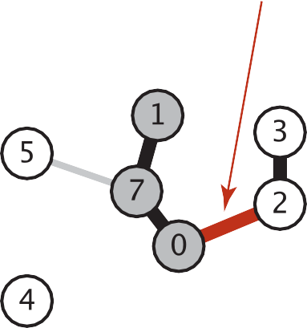
Kruskal’s Algorithm: Correctness Proof
Pf. Kruskal's algorithm is a special case of the greedy MST algorithm.
Suppose Kruskal's algorithm colors the edge e = v–w black.
Cut = set of vertices connected to v in tree T.
No crossing edge is black.
No crossing edge has lower weight.
add edge to tree

Slide 15
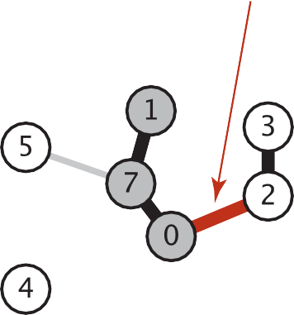
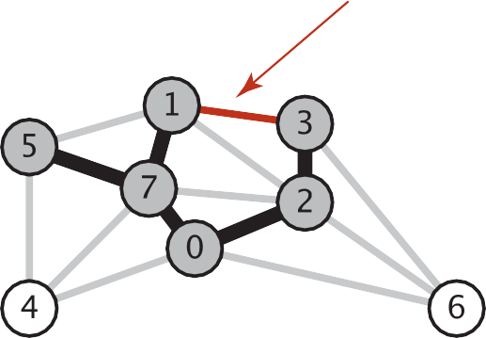









Kruskal’s Algorithm: Implementation Challenge
Challenge. Would adding edge v–w to tree T create a cycle? If not, add it.
add edge to tree
adding edge to tree would create a cycle
Solution 1. run DFS from v, check if w is reachable (T has at most V – 1 edges)
O(V)
Solution 2. Use the union-find data structure.
Maintain a set for each connected component in T.
If v and w are in same set, then adding v–w would create a cycle.
To add v–w to T, merge sets containing v and w.
O(log V)
more efficient
A union-find data structure keeps track of a set of elements partitioned into a number of disjoint subsets. It performs two useful operations:
Find: Determine which subset a particular element is in. This can be used for determining if two elements are in the same subset.
Union: Join two subsets into a single subset.
w
v
w
v
Case 1: adding v–w creates a cycle
Case 2: add v–w to T and merge sets containing v and w

Slide 16
Kruskal’s Algorithm: Java Implementation
public class KruskalMST
{
private Queue<Edge> mst = new LinkedList<Edge>();
edges in the MST
public KruskalMST(EdgeWeightedGraph G)
{
Edge[] edges = G.edges(); Arrays.sort(edges);
UF uf = new UF(G.V());
sort edges by weight
maintain connected components
for (int i = 0; i < G.E(); i++)
{
Edge e = edges[i];
int v = e.either(), w = e.other(v);
if (uf.find(v) != uf.find(w))
{
uf.union(v, w); mst.enqueue(e);
}
greedily add edges to MST
edge v–w does not create cycle
merge connected components
add edge e to MST
}
}
public Iterable<Edge> edges()
{ return mst; }
}
operation | frequency | time per op
sort | 1 | E log E
union | V - 1 | log V
find | 2 E | log V
O(E log E)
† amortized bound using weighted quick union with path compression

Slide 17
Prim’s Algorithm
Start with vertex 0 and greedily grow tree T.
Add to T the min weight edge with exactly one endpoint in T.
Repeat until V – 1 edges.
1
6
3
7
3
11
5
2
5
7
2
8
15
9
12
1
4
0
14
4
13
16
17
6

Slide 18
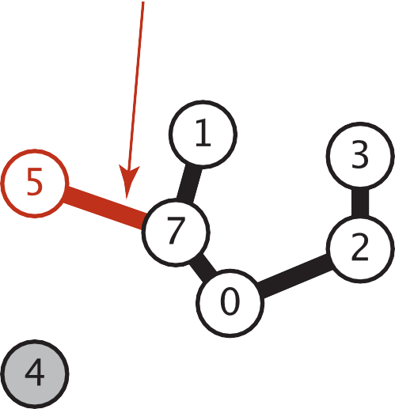
Prim’s Algorithm: Correctness Proof
Pf. Prim's algorithm is a special case of the greedy MST algorithm
Suppose edge e = min weight edge connecting a vertex on the tree to a vertex not on the tree.
Cut = set of vertices connected on tree.
No crossing edge is black.
No crossing edge has lower weight.
edge e = 7-5 added to tree

Slide 19
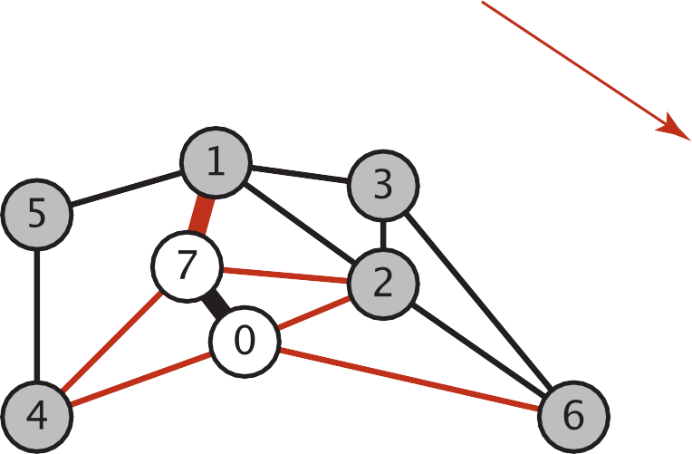
Prim’s Algorithm: Implementation Challenge
Challenge. Find the min weight edge with exactly one endpoint in T.
1-7 is min weight edge with exactly one endpoint in T
1-7
0-2
5-7
2-7
4-7
0-4
6-0
0.19
0.26
0.28
0.34
0.37
0.38
0.58
Solution 1. try all edges
O(E)
A Priority Queue is an extension of queue with following properties.
1) Every item has a priority associated with it.
2) An element with high priority is dequeued before an element with low priority.
Solution 2. Lazy solution. Maintain a PQ of edges with (at least) one endpoint in T.
Key = edge; priority = weight of edge.
Delete-min to determine next edge e = v–w to add to T.
Disregard if both endpoints v and w are marked (both in T).
Otherwise, let w be the unmarked vertex (not in T ):
add to PQ any edge incident to w (assuming other endpoint not in T)
add e to T and mark w
more efficient
O(log E)

Slide 20
Prim’s Algorithm: Lazy Implementation
0 - 7 1
2 - 3 2
1 - 7 3
0 - 2 4
5 - 7 5
1 - 3 6
1 - 5 7
2 - 7 8
4 - 5 9
1 - 2 10
4 - 7 11
0 - 4 12
2 - 6 13
3 - 6 14
0 - 6 15
4 - 6 16
Start with vertex 0 and greedily grow tree T.
Add to T the min weight edge with exactly one endpoint in T.
Repeat until V – 1 edges.
1
edges on PQ
(sorted by weight)
1
edges on PQ
(sorted by weight)
3
3
5
7
2
* 0 - 7 1
* 0 - 2 4
* 0 - 4 12
* 0 - 6 15
5
7
2
0 - 2 4
0 - 4 12
0 - 6 15
0
0
4
6
4
6
add to PQ all edges incident to 0
delete 0-7 and add to MST
no need to add 0–7 (because both endpoints are in T)
MST edges:
1
edges on PQ
(sorted by weight)
1
edges on PQ
(sorted by weight)
0 - 7 1
1 - 7 3
3
3
5
7
2
* 1 - 7 3
0 - 2 4
* 5 - 7 5
* 2 - 7 8
* 4 - 7 11
0 - 4 12
0 - 6 15
5
7
2
0 - 2 4
5 - 7 5
2 - 7 8
4 - 7 11
0 - 4 12
0 - 6 15
0
0
4
6
4
6
add to PQ all edges incident to 7
delete 1-7 and add to MST

Slide 21
Prim’s Algorithm: Lazy Implementation (Contd.)
Start with vertex 0 and greedily grow tree T.
Add to T the min weight edge with exactly one endpoint in T.
Repeat until V – 1 edges.
0 - 7 1
2 - 3 2
1 - 7 3
0 - 2 4
5 - 7 5
1 - 3 6
1 - 5 7
2 - 7 8
4 - 5 9
1 - 2 10
4 - 7 11
0 - 4 12
2 - 6 13
3 - 6 14
0 - 6 15
4 - 6 16
1
edges on PQ
(sorted by weight)
1
edges on PQ
(sorted by weight)
3
3
5
7
2
0 - 2 4
5 - 7 5
* 1 - 3 6
* 1 - 5 7
2 - 7 8
* 1 - 2 10
4 - 7 11
0 - 4 12
0 - 6 15
5
7
2
5 - 7 5
1 - 3 6
1 - 5 7
2 - 7 8
1 - 2 10
4 - 7 11
0 - 4 12
0 - 6 15
0
0
4
6
4
6
add to PQ all edges incident to 1
delete 0-2 and add to MST
1-2 and 2-7 become obsolete
(lazy implementation leaves on PQ)
MST edges:
1
edges on PQ
(sorted by weight)
1
edges on PQ
(sorted by weight)
3
3
0 - 7 1
1 - 7 3
0 - 2 4
2 - 3 2
5
7
2
* 2 - 3 2
5 - 7 5
1 - 3 6
1 - 5 7
2 - 7 8
1 - 2 10
4 - 7 11
0 - 4 12
* 2 - 6 13
0 - 6 15
5
7
2
5 - 7 5
1 - 3 6
1 - 5 7
2 - 7 8
1 - 2 10
4 - 7 11
0 - 4 12
2 - 6 13
0 - 6 15
0
0
4
6
4
6
add to PQ all edges incident to 2
delete 2-3 and add to MST

Slide 22
Prim’s Algorithm: Lazy Implementation (Contd.)
Start with vertex 0 and greedily grow tree T.
Add to T the min weight edge with exactly one endpoint in T.
Repeat until V – 1 edges.
0 - 7 1
2 - 3 2
1 - 7 3
0 - 2 4
5 - 7 5
1 - 3 6
1 - 5 7
2 - 7 8
4 - 5 9
1 - 2 10
4 - 7 11
0 - 4 12
2 - 6 13
3 - 6 14
0 - 6 15
4 - 6 16
edges on PQ
(sorted by weight)
edges on PQ
(sorted by weight)
1
1
3
3
5
5 - 7 5
1 - 3 6
1 - 5 7
2 - 7 8
1 - 2 10
4 - 7 11
0 - 4 12
2 - 6 13
* 3 - 6 14
0 - 6 15
5
1 - 3 6
1 - 5 7
2 - 7 8
1 - 2 10
4 - 7 11
0 - 4 12
2 - 6 13
3 - 6 14
0 - 6 15
7
2
7
2
0
0
4
6
4
6
add to PQ all edges incident to 3
delete 5-7 and add to MST
MST edges:
edges on PQ
(sorted by weight)
edges on PQ
(sorted by weight)
1
1
0 - 7 1
1 - 7 3
0 - 2 4
2 - 3 2
5 - 7 5
4 - 5 9
3
3
5
1 - 3 6
1 - 5 7
2 - 7 8
* 4 - 5 9
1 - 2 10
4 - 7 11
0 - 4 12
2 - 6 13
3 - 6 14
0 - 6 15
5
1 - 2 10
4 - 7 11
0 - 4 12
2 - 6 13
3 - 6 14
0 - 6 15
7
2
7
2
0
0
4
6
4
6
add to PQ all edges incident to 5
delete 1-3, 1-5, and 2-7
and discard obsolete edge
delete 4-5 and add to MST

Slide 23
Prim’s Algorithm: Lazy Implementation (Contd.)
0 - 7 1
2 - 3 2
1 - 7 3
0 - 2 4
5 - 7 5
1 - 3 6
1 - 5 7
2 - 7 8
4 - 5 9
1 - 2 10
4 - 7 11
0 - 4 12
2 - 6 13
3 - 6 14
0 - 6 15
4 - 6 16
Start with vertex 0 and greedily grow tree T.
Add to T the min weight edge with exactly one endpoint in T.
Repeat until V – 1 edges.
edges on PQ
(sorted by weight)
edges on PQ
(sorted by weight)
1
1
3
3
5
1 - 2 10
4 - 7 11
0 - 4 12
2 - 6 13
3 - 6 14
0 - 6 15
* 4 - 6 16
5
3 - 6 14
0 - 6 15
4 - 6 16
7
2
7
2
0
0
4
6
4
6
add to PQ all edges incident to 4
delete 1-2, 4-7, and 0-4
and discard obsolete edge
delete 2-6 and add to MST
MST edges:
0 - 7 1
1 - 7 3
0 - 2 4
2 - 3 2
5 - 7 5
4 - 5 9
2 - 6 13
stop since V-1 edges

Slide 24
Prim’s Algorithm: Lazy Implementation in Java
public class LazyPrimMST {
implement priority queue
private | boolean[] marked; | // | MST vertices
private | Queue<Edge> mst; | // | MST edges
private | MinPQ<Edge> pq; | // | PQ of edges
operation | frequency | binary heap
delete min | E | log E
insert | E | log E
public LazyPrimMST(WeightedGraph G) {
pq = new MinPQ<Edge>(); mst = new Queue<Edge>();
marked = new boolean[G.V()]; visit(G, 0);
O(E log E)
assume G is connected
while (!pq.isEmpty() && mst.size() < G.V() - 1) {
repeatedly delete the
min weight edge e = v–w from PQ
ignore if both endpoints in T
add edge e to tree
Edge e = pq.delMin();
int v = e.either(), w = e.other(v);
if (marked[v] && marked[w]) continue; mst.enqueue(e);
if (!marked[v]) visit(G, v);
if (!marked[w]) visit(G, w);
add v or w to tree
}
}
private void visit(WeightedGraph G, int v) {
marked[v] = true;
for (Edge e : G.adj(v))
if (!marked[e.other(v)]) pq.insert(e);
}
public Iterable<Edge> mst()
{ return mst; }
add v to T
for each edge e = v–w, add to PQ if w not already in T

Slide 25
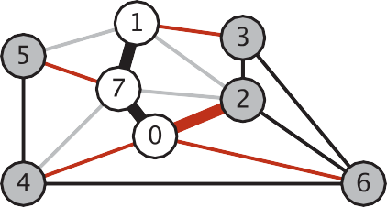
Prim’s Algorithm: Eager Implementation
Challenge. Find the min weight edge with exactly one endpoint in T.
pq has at most one entry per vertex
Eager solution. Maintain a PQ of vertices connected by an edge to T, where priority of vertex v = weight of shortest edge connecting v to T.
Delete min vertex v and add its associated edge e = v–w to T.
Update PQ by considering all edges e = v–x incident to v
ignore if x is already in T
add x to PQ if not already on it
if already on PQ, decrease priority of x if v–x becomes shortest edge connecting x to T
0
1 | 1-7 | 0.19
2 | 0-2 | 0.26
3 | 1-3 | 0.29
4 | 0-4 | 0.38
5 | 5-7 | 0.28
6 | 6-0 | 0.58
7 | 0-7 | 0.16
red: on PQ
black: on MST
Motivation: the height of the binary-heap PQ would be reduced →
O(log V)

Slide 26
Prim’s Algorithm: Eager Implementation
Start with vertex 0 and greedily grow tree T.
Add to T the min weight edge with exactly one endpoint in T.
Repeat until V – 1 edges.
MST edges:
0 - 7 1
vertices on PQ
(sorted by weight)
vertices on PQ
(sorted by weight)
1
1
3
v
edgeTo[ ]
distTo[ ]
3
v
edgeTo[ ]
distTo[ ]
5
7
2
* 7 0 - 7 1
* 2 0 - 2 4
* 4 0 - 4 12
* 6 0 - 6 15
5
7
2
2 0 - 2 4
4 0 - 4 12
6 0 - 6 15
0
0
4
6
4
6
add to PQ the vertices incident to 0
Delete 7 and add 0-7 to T
0 - 7 1
2 - 3 2
1 - 7 3
0 - 2 4
5 - 7 5
1 - 3 6
1 - 5 7
2 - 7 8
4 - 5 9
1 - 2 10
4 - 7 11
0 - 4 12
2 - 6 13
3 - 6 14
0 - 6 15
4 - 6 16
already a better
connection to 2
(discard)
a better
connection to 4
(decrease key of 4)
vertices on PQ
(sorted by weight)
1
3
v
edgeTo[ ]
distTo[ ]
5
7
2
* 1 1 - 7 3
2 0 - 2 4
* 5 5 - 7 5
4 0 - 4 12
6 0 - 6 15
0
4 - 7
11
4
6
not the best
connection to 4
(discard)
add to PQ the vertices incident to 7

Slide 27
Prim’s Algorithm: Eager Implementation
MST edges:
Start with vertex 0 and greedily grow tree T.
Add to T the min weight edge with exactly one endpoint in T.
Repeat until V – 1 edges.
0 - 7 1
1 - 7 3
0 - 2 4
already a better
connection to 5 and 2
(discard)
vertices on PQ
(sorted by weight)
vertices on PQ
(sorted by weight)
1
1
v
edgeTo[ ]
distTo[ ]
3
v
edgeTo[ ]
distTo[ ]
3
2 0 - 2 4
5 5 - 7 5
* 3 1 - 3 6
4 4 - 7 11
6 0 - 6 15
5
7
2
2 0 - 2 4
5 5 - 7 5
4 4 - 7 11
6 0 - 6 15
5
7
2
0
0
4
6
4
6
add to PQ the vertices incident to 1
0 - 7 1
2 - 3 2
1 - 7 3
0 - 2 4
5 - 7 5
1 - 3 6
1 - 5 7
2 - 7 8
4 - 5 9
1 - 2 10
4 - 7 11
0 - 4 12
2 - 6 13
3 - 6 14
0 - 6 15
4 - 6 16
Delete 1 and add 1-7 to T
vertices on PQ
(sorted by weight)
1
3
v
edgeTo[ ]
distTo[ ]
5
7
2
5 5 - 7 5
3 1 - 3 6
4 4 - 7 11
6 0 - 6 15
0
4
6
Delete 2 and add 0-2 to T

Slide 28
Prim’s Algorithm: Eager Implementation
MST edges:
Start with vertex 0 and greedily grow tree T.
Add to T the min weight edge with exactly one endpoint in T.
Repeat until V – 1 edges.
0 - 7 1
1 - 7 3
0 - 2 4
2 - 3 2
a better
connection to 3
(decrease key of 3)
a better
connection to 6
(decrease key of 6)
0 - 7 1
2 - 3 2
1 - 7 3
0 - 2 4
5 - 7 5
1 - 3 6
1 - 5 7
2 - 7 8
4 - 5 9
1 - 2 10
4 - 7 11
0 - 4 12
2 - 6 13
3 - 6 14
0 - 6 15
4 - 6 16
vertices on PQ
(sorted by weight)
1
3
v
edgeTo[ ]
distTo[ ]
5
7
2
5 5 - 7 5
3 1 - 3 6
4 4 - 7 11
6 0 - 6 15
2 - 3
2
0
4
6
add to PQ the vertices incident to 2
2 - 6
13
already a better
connection to 6
(discard)
no longer the best
connection to 3 and 6
(discard)
1
vertices on PQ
(sorted by weight)
3
5
7
v
edgeTo[ ]
distTo[ ]
2
0
5 5 - 7 5
4 4 - 7 11
6 2 - 6 13
4
6
Delete 3 and add 2-3 to T
add to PQ the vertices incident to 3

Slide 29
Prim’s Algorithm: Eager Implementation
MST edges:
Start with vertex 0 and greedily grow tree T.
Add to T the min weight edge with exactly one endpoint in T.
Repeat until V – 1 edges.
0 - 7 1
2 - 3 2
1 - 7 3
0 - 2 4
5 - 7 5
1 - 3 6
1 - 5 7
2 - 7 8
4 - 5 9
1 - 2 10
4 - 7 11
0 - 4 12
2 - 6 13
3 - 6 14
0 - 6 15
4 - 6 16
0 - 7 1
1 - 7 3
0 - 2 4
2 - 3 2
5 - 7 5
4 - 5 9
2 - 6 13
1
vertices on PQ
(sorted by weight)
no longer the best
connection to 4
(discard)
3
5
7
v
edgeTo[ ]
distTo[ ]
2
a better
connection to 4
(decrease key of 6)
4 - 5
9
0
4 4 - 7 11
6 2 - 6 13
4
6
Delete 5 and add 5-7 to T
1
add to PQ the vertices incident to 5
3
already a better
connection to 6
(discard)
5
7
2
1
vertices on PQ
(sorted by weight)
3
0
5
4
6
O(E log V)
7
2
v
edgeTo[ ]
distTo[ ]
Delete 2 and add 2-6 to T
0
6 2 - 6 13
operation | frequency | time per op
Insert | E | log V
delete min | E | log V
decrease key | E | log V
4
6
Delete 4 and add 4-5 to T
add to PQ the vertices incident to 4

Slide 30
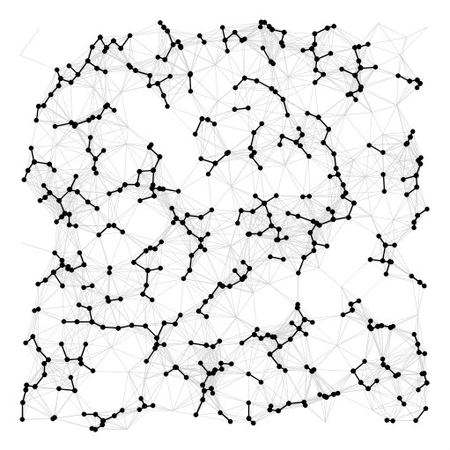
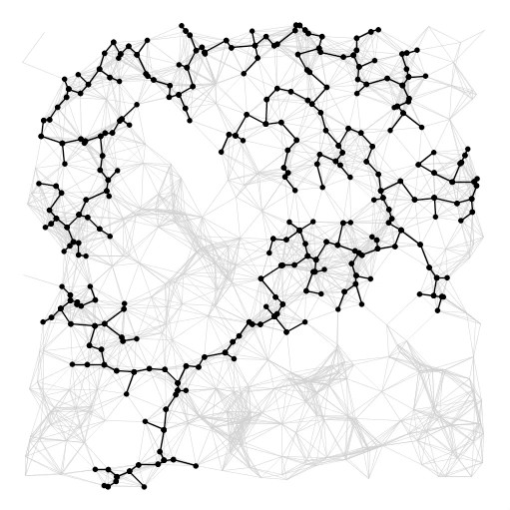
Summary
algorithm
visualization
bottleneck
running time
sorting union–find
Kruskal
E log V
Prim
priority queue
E log V
https://www.youtube.com/watch?v=vmWSnkBVvQ0

Slide 31
Additional Resources
Union-Find
https://www.geeksforgeeks.org/union-find/
Priority Queue
https://www.geeksforgeeks.org/priority-queue-set-1-introduction/
Binary Heap
https://www.cs.cmu.edu/~adamchik/15-121/lectures/Binary%20Heaps/heaps.html

